Slide 1
CS425 DATABASE ORGANIZATION PROJECT
Shahrukh Sohail

Slide 2
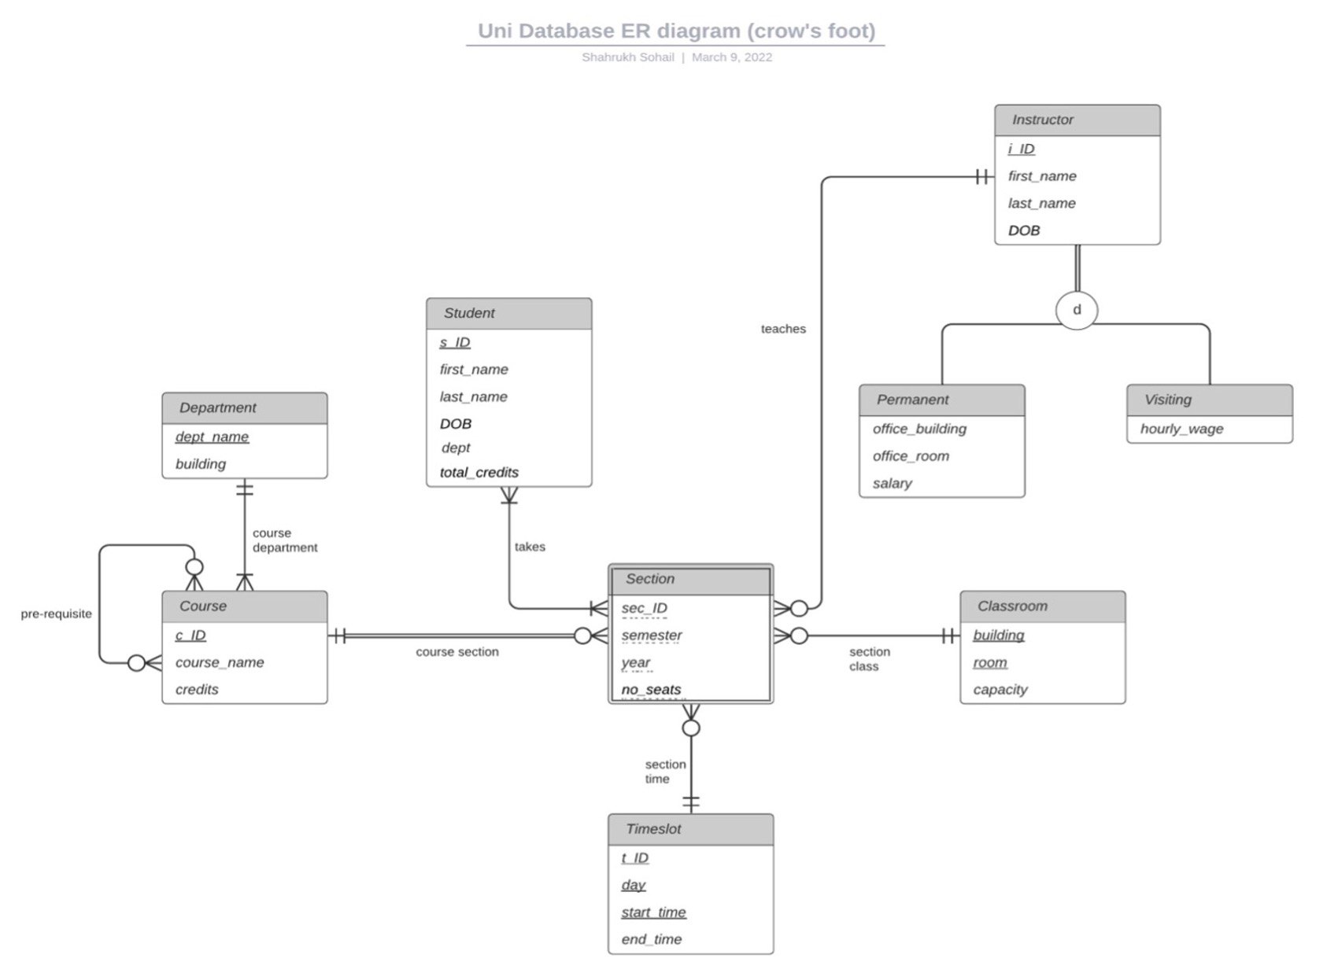
UNIVERSITY DB DESIGN

Slide 3
PYTHON: WEB APPLICATION
FLASK #Python library
Psycopg2 #to connect to PostgreSQL DB
Html files #web-based user interface

Slide 4
PYTHON FLASK: WEB APPLICATION How to Run
Place all files in one folder (static & templates folder + app.py)
Open folder in Visual Studio Code (VS Code)
Run app.py
Open http://127.0.0.1:8080/ in a web browser
In browser settings disable cache (Recommended)

Slide 5
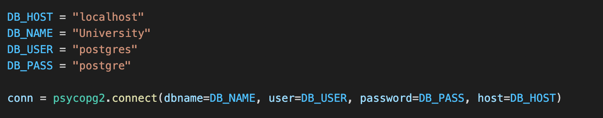
PYTHON FLASK: WEB APPLICATION Connect to PostgreSQL DB
Psycopg2 is used to connect to PostgreSQL DB

Slide 6
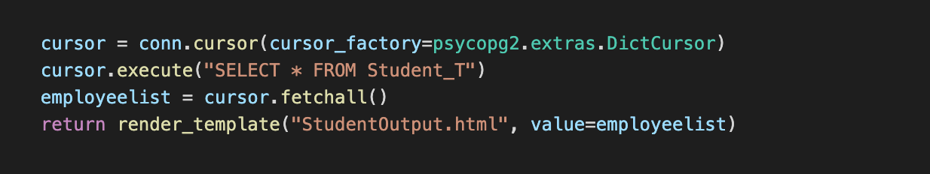
PYTHON FLASK: WEB APPLICATION Search data in Database
Psycopg2 is used to Query results from PostgreSQL DB

Slide 7
PYTHON FLASK: WEB APPLICATION Search data in Database
Run app.py
Open http://127.0.0.1:8080/ in a web browser.
Use the options and filters to navigate through the Web Application.

Slide 8

PYTHON FLASK: WEB APPLICATION

Slide 9
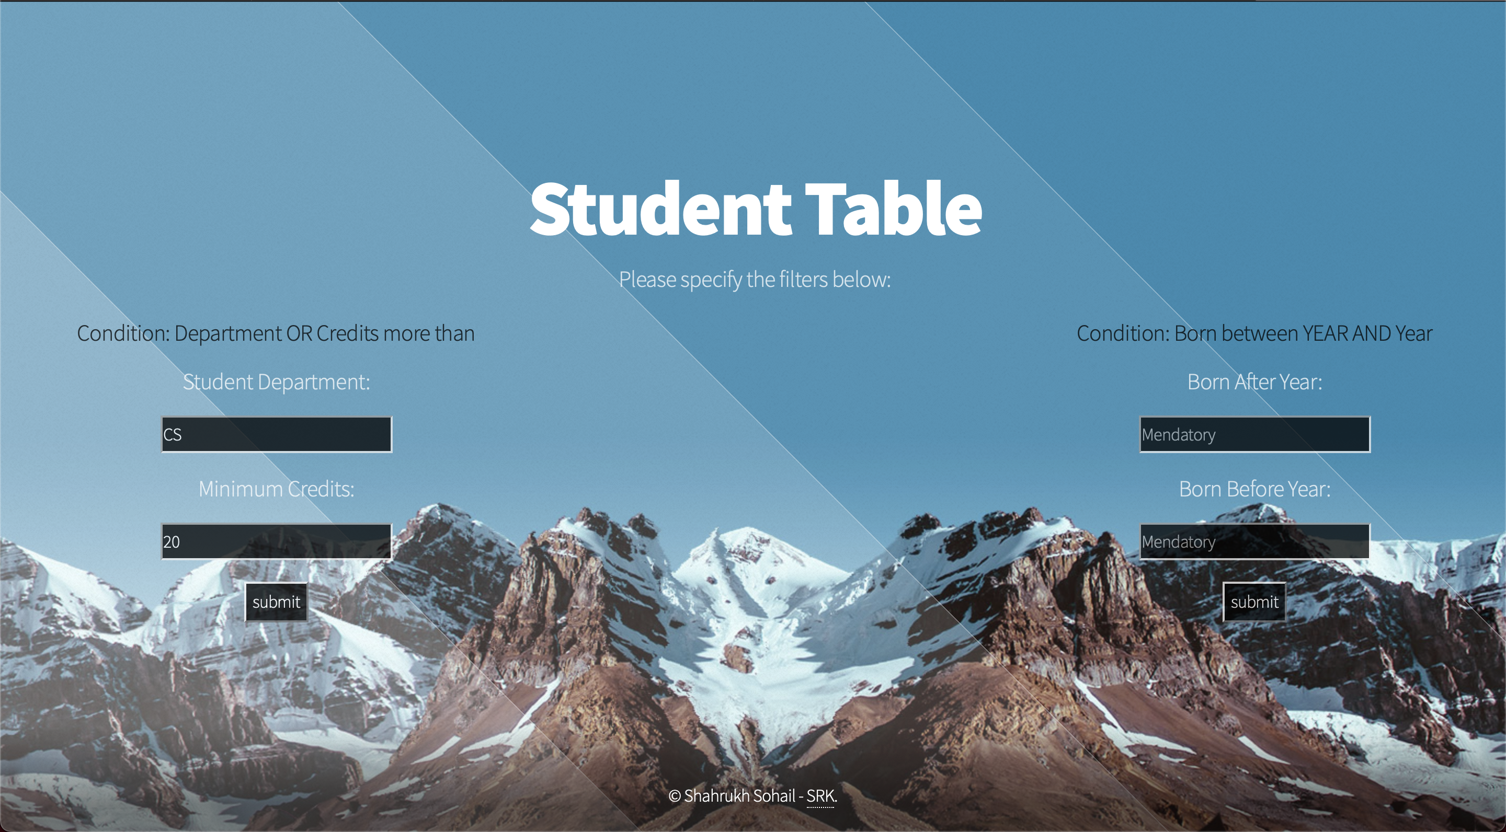
PYTHON FLASK: WEB APPLICATION Student Table

Slide 10
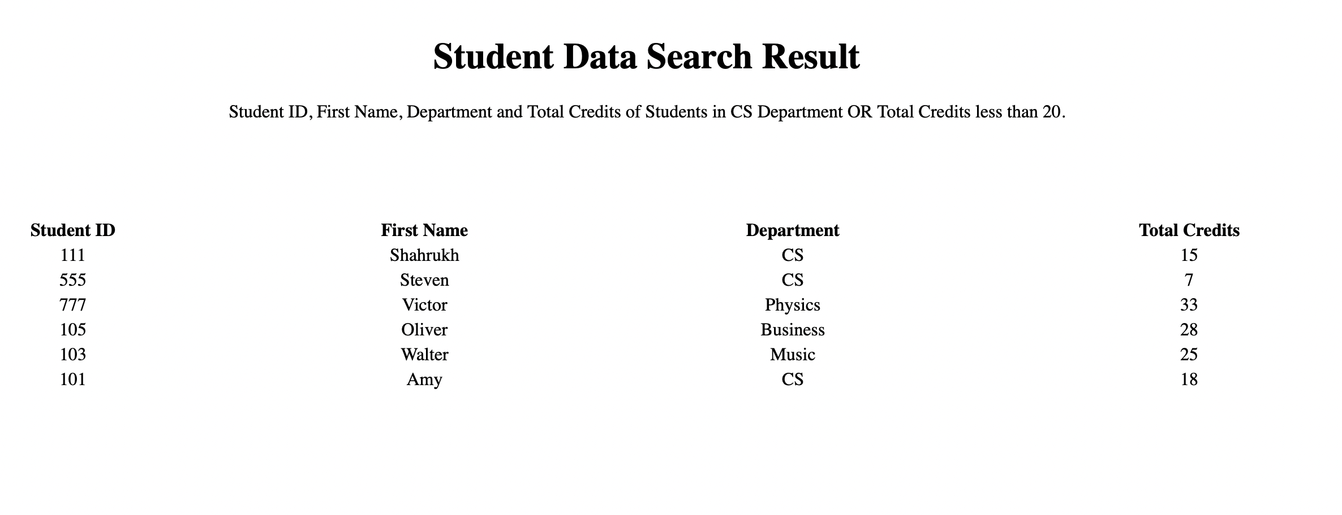
PYTHON FLASK: WEB APPLICATION Student Table

Slide 11
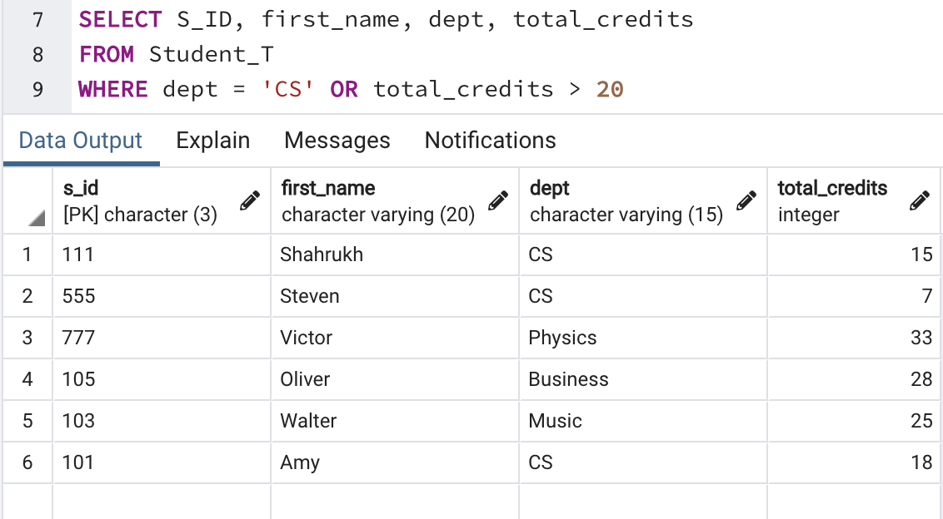
PYTHON FLASK: WEB APPLICATION Student Table
QUERY:
Find Student ID, First Name, Department and Total Credits of Students in CS department OR total credits less than 20.

Slide 12
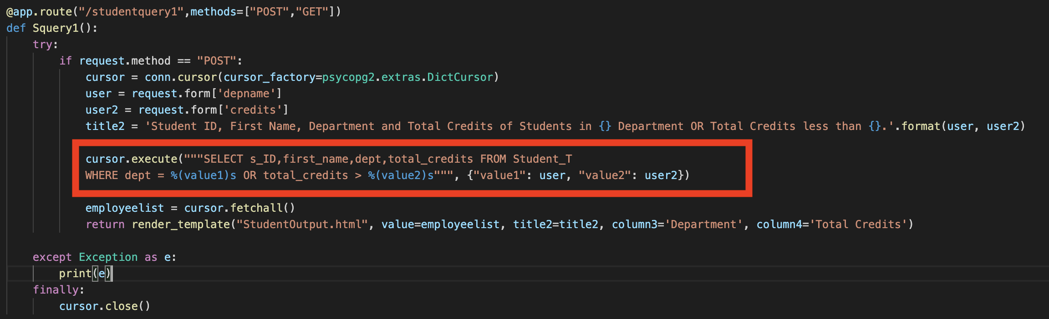
PYTHON FLASK: WEB APPLICATION Student Table
QUERY:
Find Student ID, First Name, Department and Total Credits of Students in department in input1 OR total credits less than input2.

Slide 13
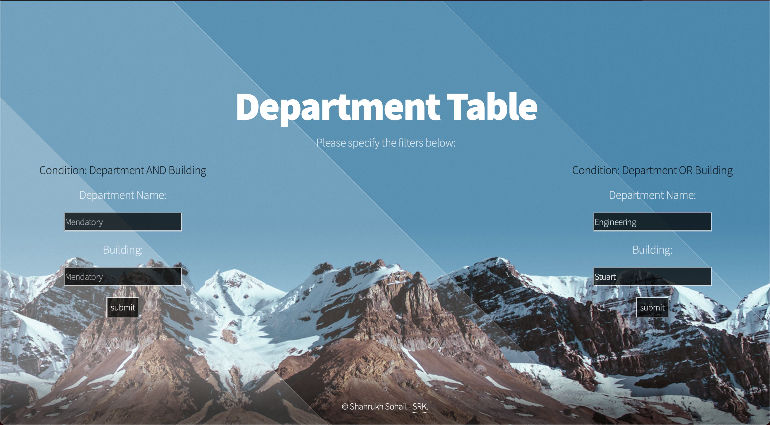
PYTHON FLASK: WEB APPLICATION Department Table

Slide 14
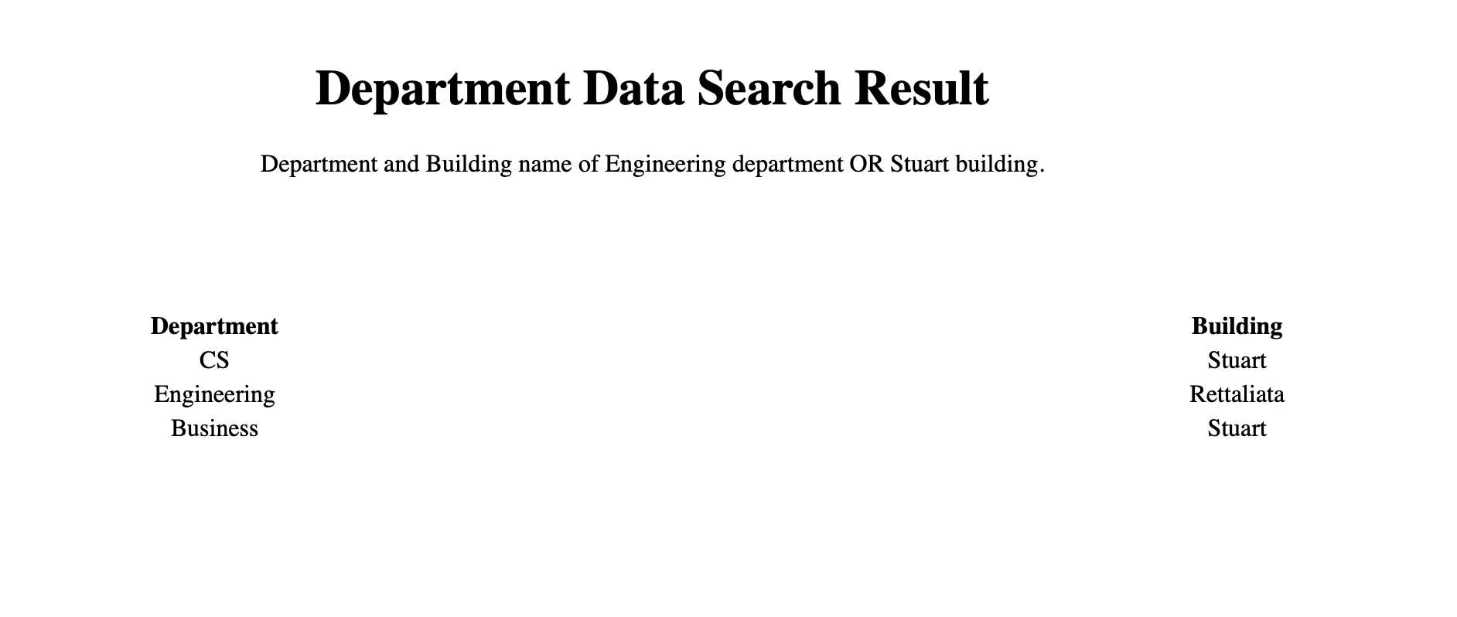
PYTHON FLASK: WEB APPLICATION Department Table

Slide 15
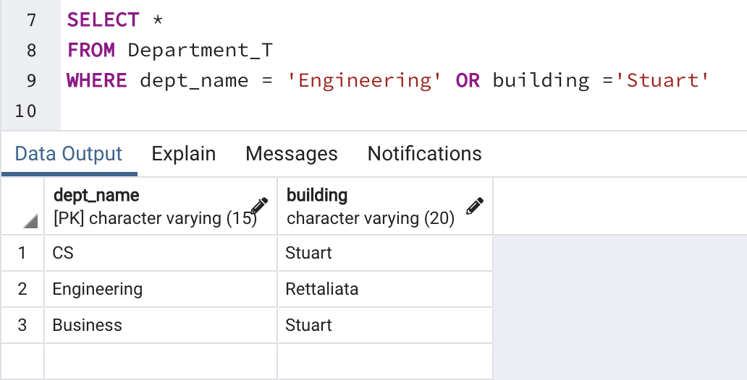
PYTHON FLASK: WEB APPLICATION Department Table
QUERY:
Find Department and Building name of Engineering department OR Stuart building.

Slide 16
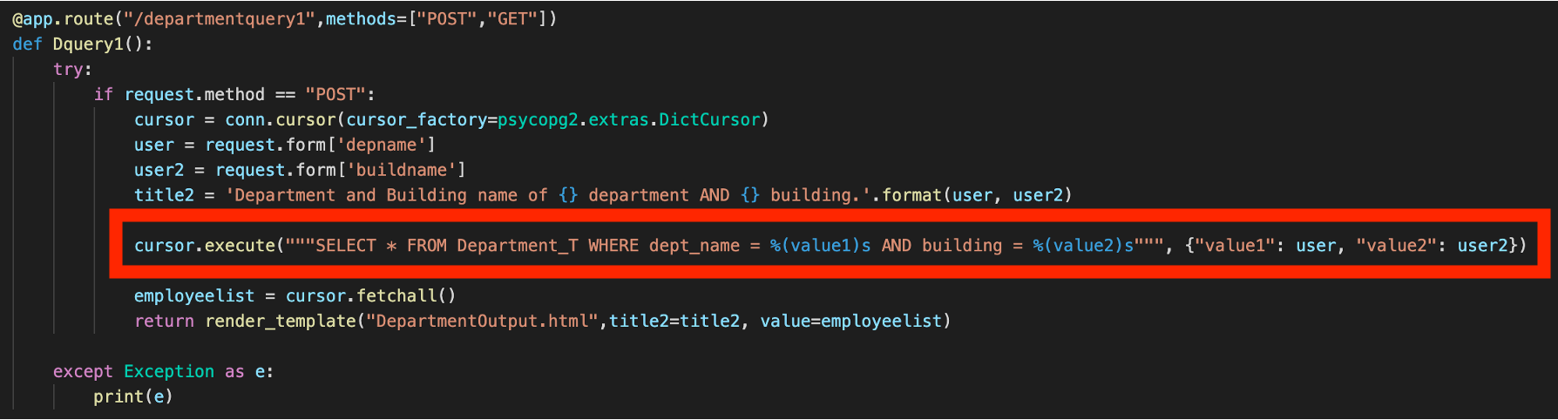
PYTHON FLASK: WEB APPLICATION Department Table
QUERY:
Find Department and Building name where department is input1 OR building is input2.

Slide 17
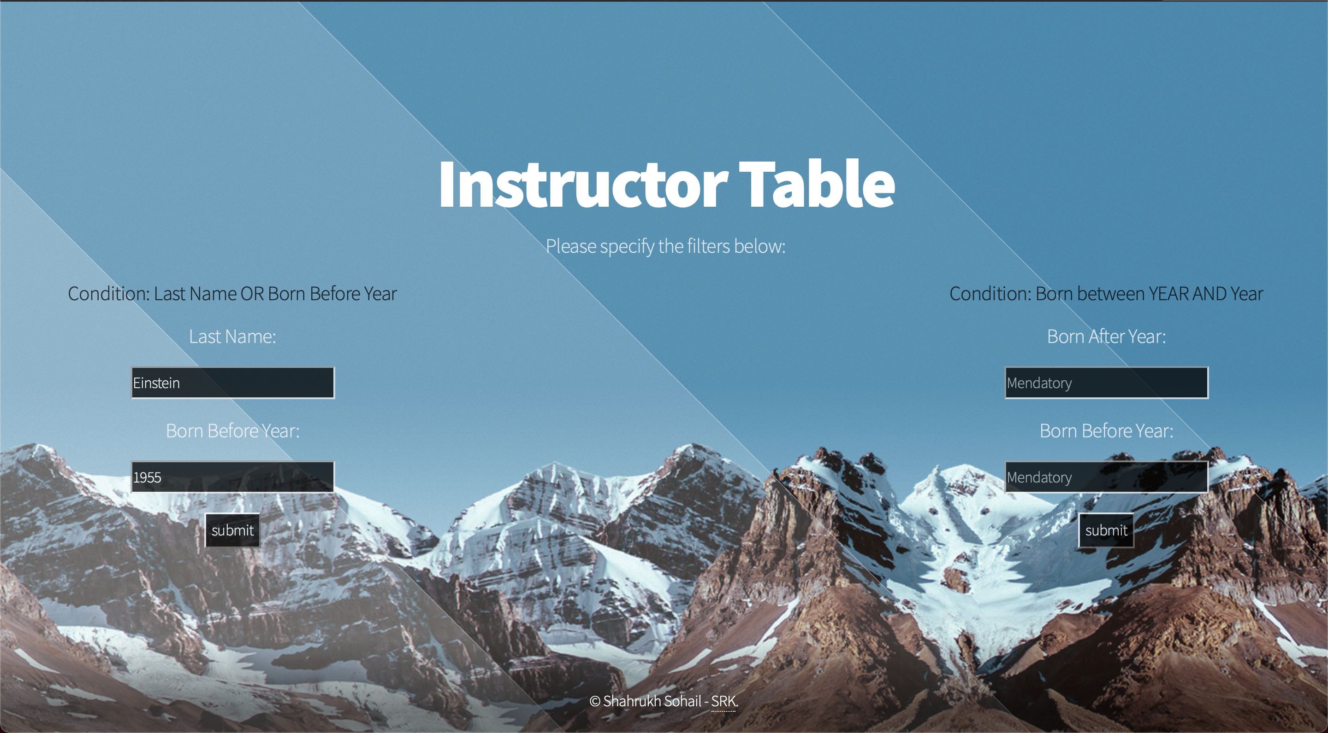
PYTHON FLASK: WEB APPLICATION Instructor Table

Slide 18
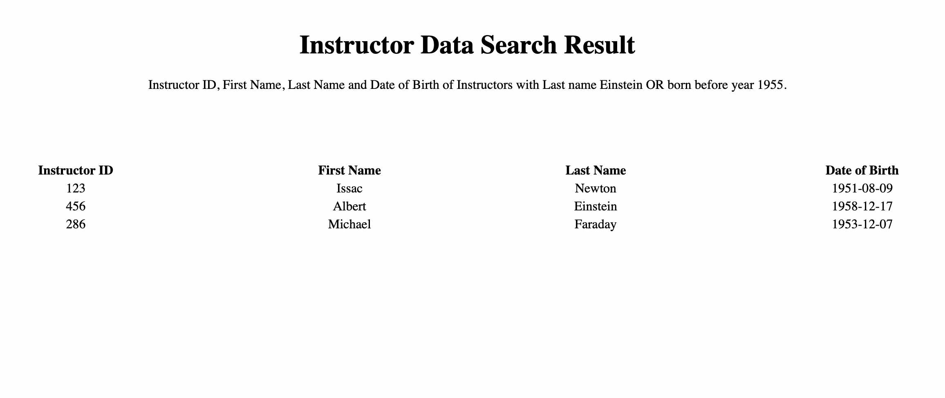
PYTHON FLASK: WEB APPLICATION Instructor Table

Slide 19
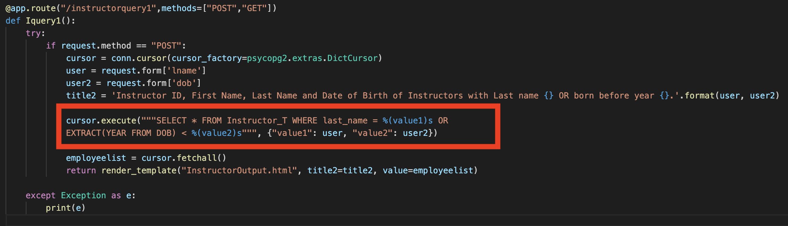
PYTHON FLASK: WEB APPLICATION Instructor Table
QUERY:
Find Instructors where last name is input1 OR born before year input2.

Slide 20
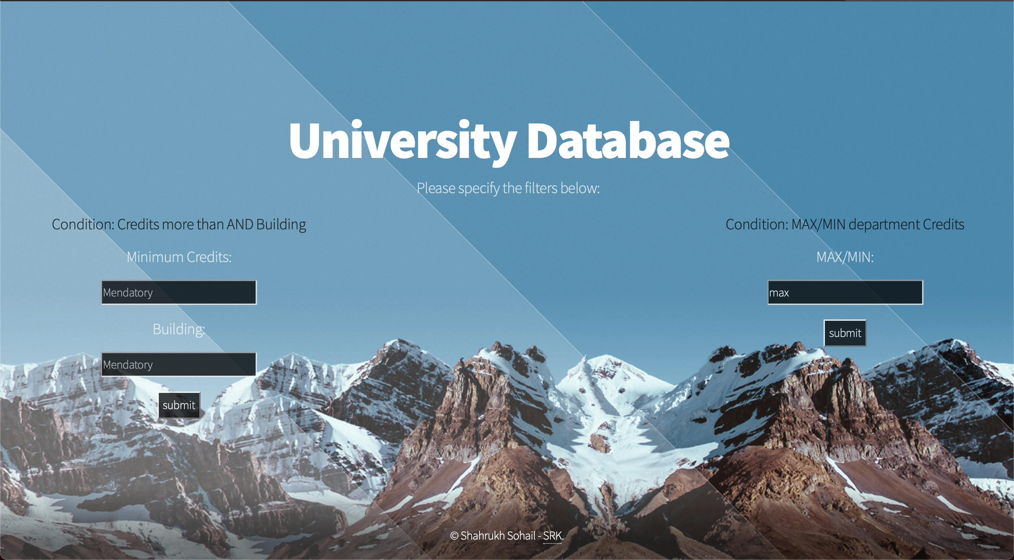
PYTHON FLASK: WEB APPLICATION Complex Queries

Slide 21
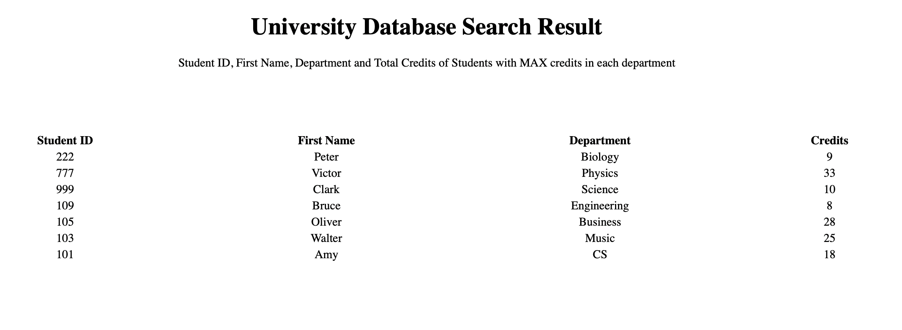
PYTHON FLASK: WEB APPLICATION Complex Queries

Slide 22
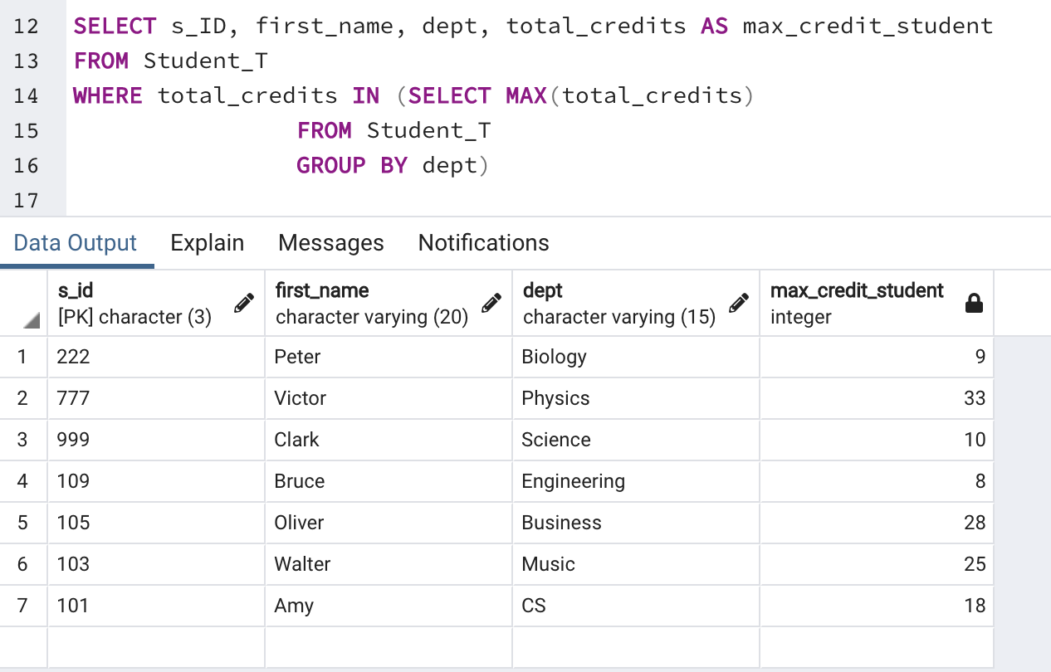
PYTHON FLASK: WEB APPLICATION Complex Queries
QUERY:
Find Student ID, First Name, Department and Total Credits of Students with maximum credits in each department.

Slide 23
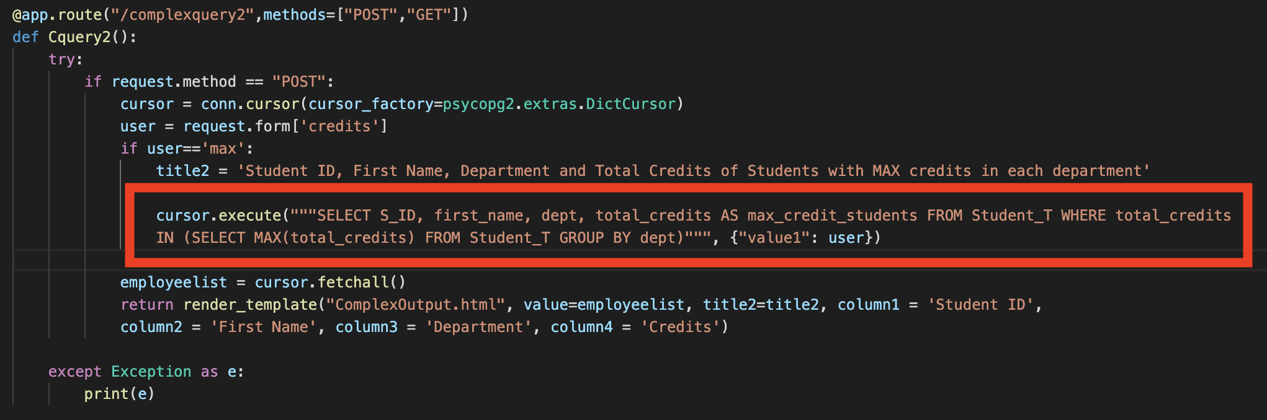
PYTHON FLASK: WEB APPLICATION Complex Queries
QUERY:
Find Student ID, First Name, Department and Total Credits of Students with maximum credits in each department.

Slide 24
PYTHON FLASK: WEB APPLICATION
THE END

